Slide 1

T-Level Mentoring Project
Console based uniform ordering system
Developed by: Eliyan Riasat, Sean Stewart and Mitchell Street

Slide 2


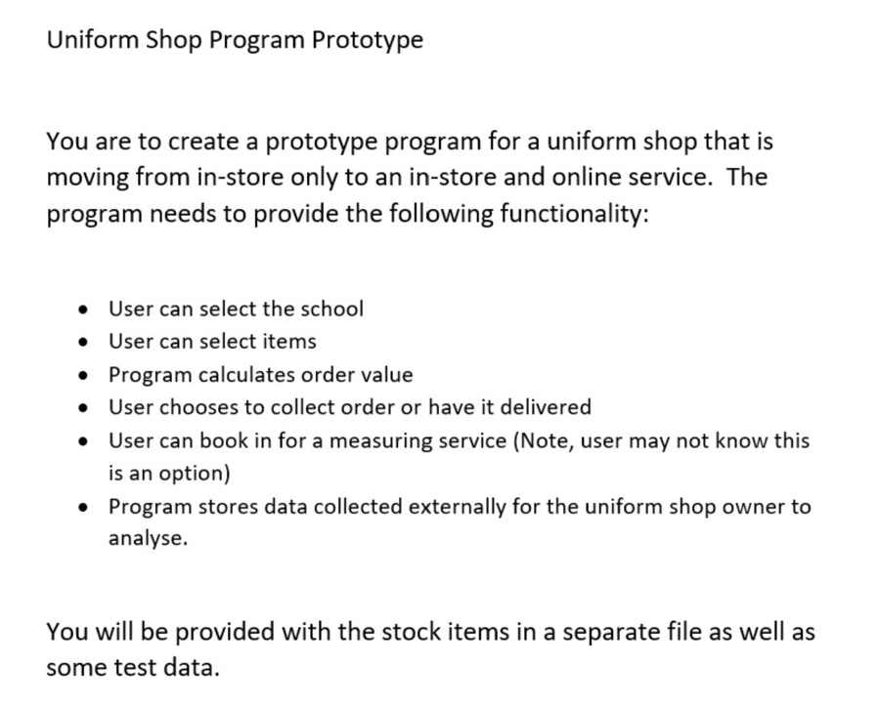



What was required?
A console-based program made for a uniform shop to allow customers to select a school, the items for that school and purchase all these items from the cart.
The user experience is top priority due to console-based programs being non-user friendly by design.
Data validation and other features were implemented to improve beyond the spec but the main requirements were still met – only improved upon.

Slide 3
How did the program meet the spec?
The user can select the school once entering the “Browse Items” menu. The relevant items can then be selected, these items are stored along with the price being calculated later on in the cart.
More information provided on the next pages.

Slide 4

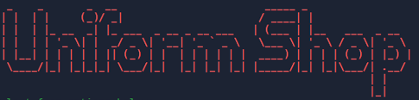
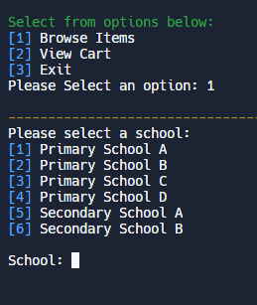
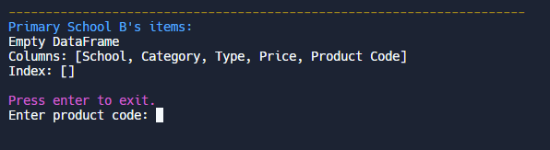
The user experience
The following features are intended to improve the UX (User Experience):
The title is displayed in a more graphical form (ASCII art)
All selections are simplified to single or very few numerical inputs
Distinctive colours are utilised to separate
content and make text easy to interpret

Slide 5
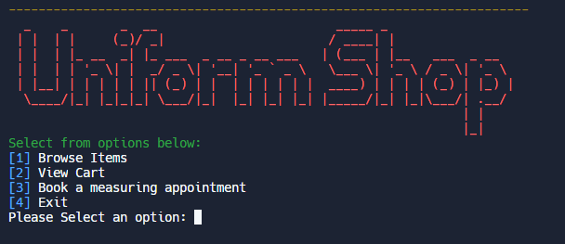

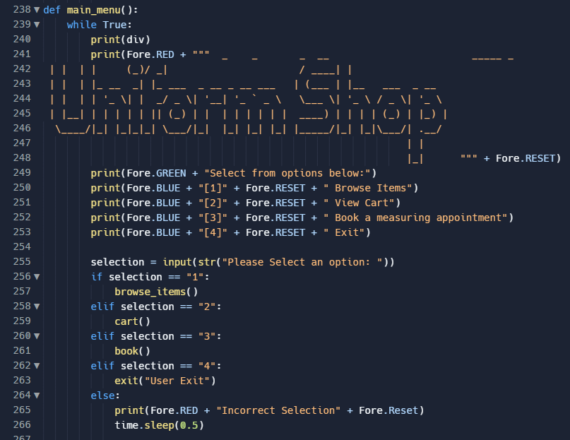
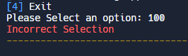
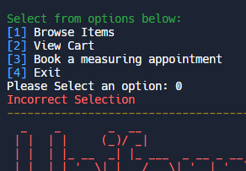
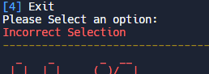
The main menu
The first thing the user sees when the program loads up, the title presented as ASCII art is displayed with each of the options available to the user.
All of the sub-menus are accessible through this main menu and as standard, the input are data validated:
As they are throughout the program.

Slide 6
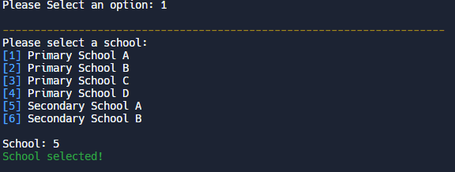
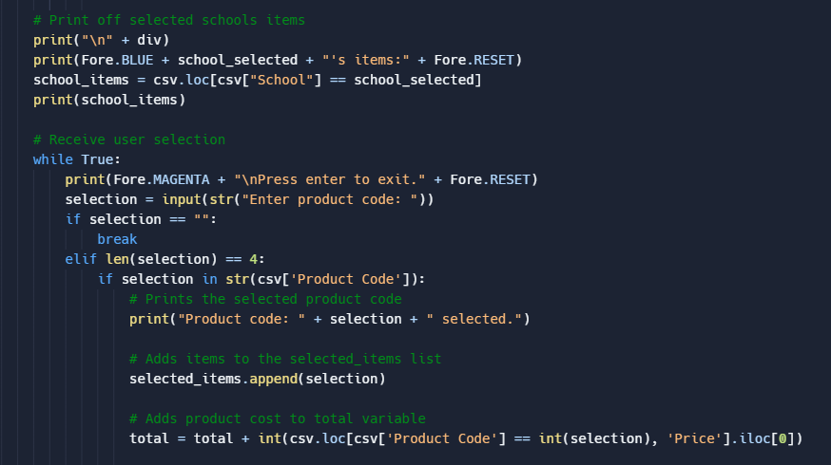
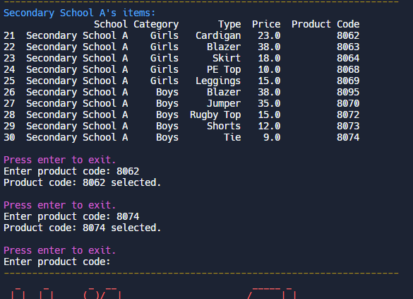
Browse items
Once the user has selected their desired school, the items tagged with that school are displayed with all their relevant information.
Rather than complicating the selection process, there is no further filtering other than by schools, due to the tediousness of exiting menus to select different items.

Slide 7
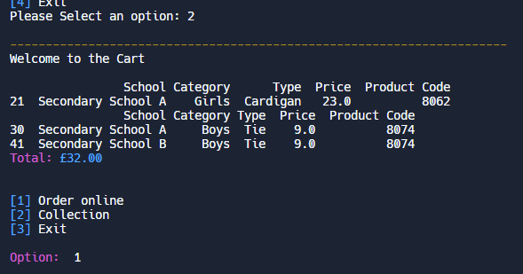


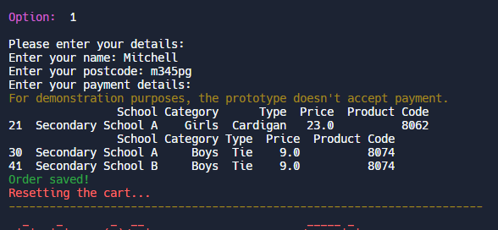

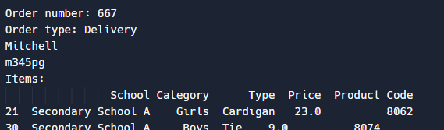
View cart
Once all of the items are selected, the user can view the final price and choose to either order them online (delivery), arrange a collection or exit to continue shopping.
For example, if the user decides they want them delivered then their name, address and payment details are requested and saved
All orders are saved in the attached log.txt file.

Slide 8
What did the mentoring students learn?
Eliyan
Through this experience I’ve learnt to create user validation in our code which has been a fun and interesting experience, I’ve also learnt to code different sets of code within our program, such as: clothing sizes and how to code whether an item is in stock or not.
This has been one of the longer programs we’ve done and learning how to expand each section of the code and to extend it has been a great experience. I’ve also learnt how to use Pycharm and GitHub so that I can use these resources in the future to effectively improve further programs.
Sean
Yet to be added.
Notes:
Fill this in

Slide 9
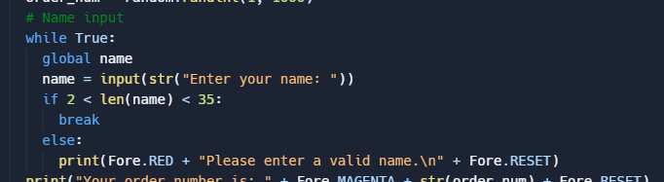
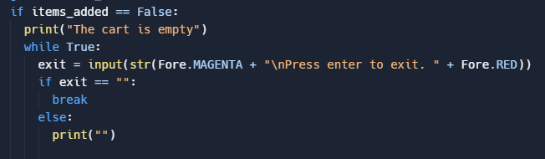
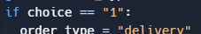
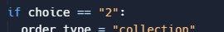
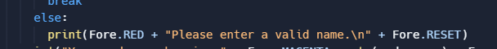
Data validation Why and how it was taught to the first years
To prevent syntax errors and logic errors,
data validation is implemented on
almost every process in the program.
The main method utilised was using statements.
The basic concept is that by taking in every input as a string, the if-else statements can request exact inputs without risking the program from crashing due to an invalid data type.

Slide 10
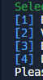
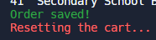
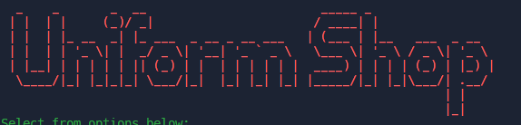


Colorama The best colour module
‘Colorama’ is seen throughout the program, it is a vital asset in improving the UX by clearly diversifying the different outputs on the screen.
Colours are the best – if not the only – way to improve the appearance of a console-based program.

Slide 11


Conclusion
Program works, no missing requirements from the brief, not one.
(to github)

